Slide 1
Course Duration 01 hr. 00 mins.
Documentum D2 Life Science Solution Suite
D2LS Overview
Notes:
Please add the audio note here.

Slide 2
Overview
Documentum D2 is a web-based application that enables users to store, retrieve, and manage documents in a Documentum repository. It is highly customizable through a configuration application that does not require programming knowledge. Documentum D2 consists of the following components:
Documentum D2 Configuration (D2-Config): The configuration application that enables you to configure settings for security, workflows, document classification, and the client user interface.
Documentum D2 Client (D2 Client): The main application that is used to interact with documents in the repository. AdditionalDocumentumD2componentsthatareusedinDocumentumforeTMFare:
Documentum
D2 Office Integration (O2): Microsoft Office and Outlook properties synchronization for documents and email.
Documentum D2 PDF Integration (C2): PDF file control for watermarking and controlled printing.
Documentum D2 Recycle bin integration (D2-Bin): Recycle bin control for restoring deleted documents
Click Play to continue.
Notes:
Please add the audio note here.

Slide 3

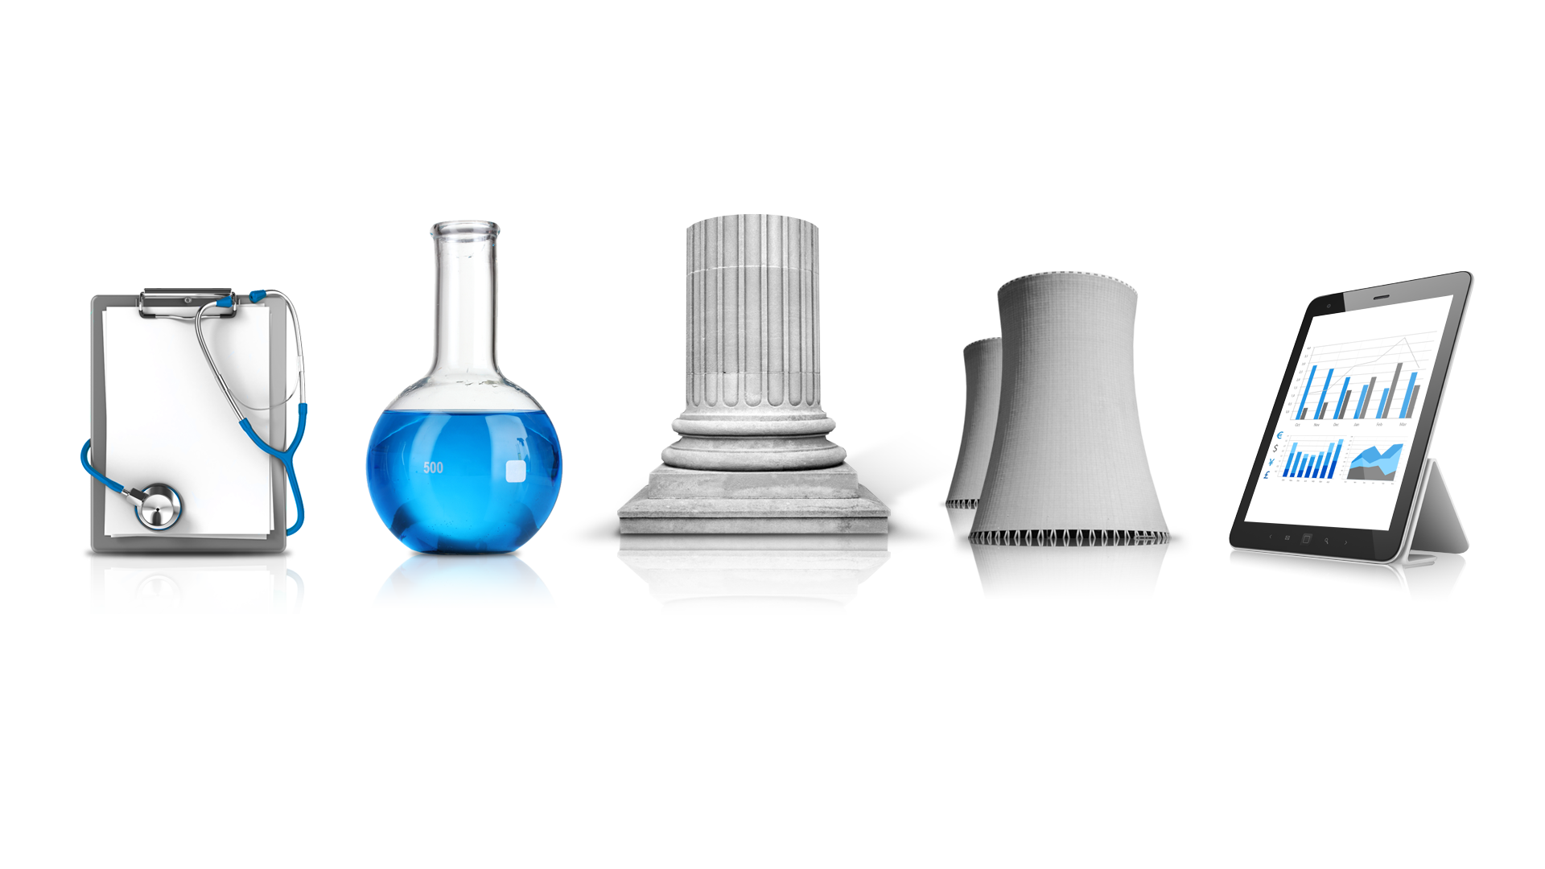
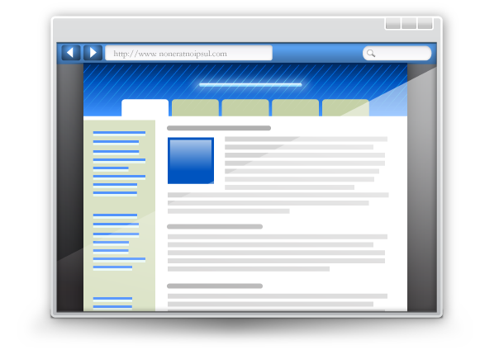

OpenText DOCUMENTUM FOR LIFE SCIENCES SOLUTION SUITE
UNIFIED SOLUTION LAYER
REGULATORY
ELECTRONIC TRIAL MASTER FILE
RESEARCH & DEVELOPMENT
SUBMISSION STORE & VIEW
QUALITY & MANUFACTURING
Trial Master File
Nonclinical
Regulatory Submissions
Procedural
Clinical*
Clinical*
Manufacturing
Quality**
Regulatory Correspondence
Regulatory
Quality**
Change Request
DIA EDM and TMF Reference Model Taxonomies (Life Sciences Foundation)
Lifecycles and Workflow
Security Models
Property Registration
Compliance Features
Controlled Document Foundation
DOCUMENTUM D2: Modern UI and Flexible Business Rules
DOCUMENTUM: Proven Compliant and Scalable Platform
* Clinical documents can be stored in either the eTMF or R&D Module
** Quality documents can be stored in either the Quality or R&D Module
Click Play to continue.
Notes:
Please add the audio note here.

Slide 4
D2LS Object Model Overview
Click Play to continue.
Notes:
Please add the audio note here.

Slide 5
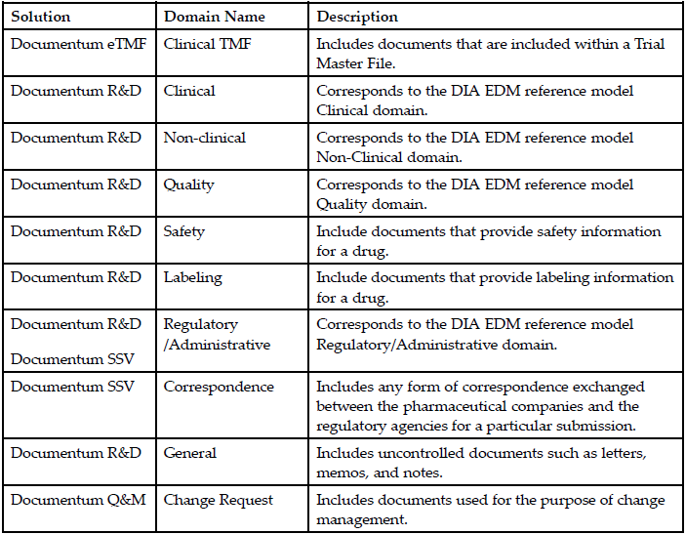
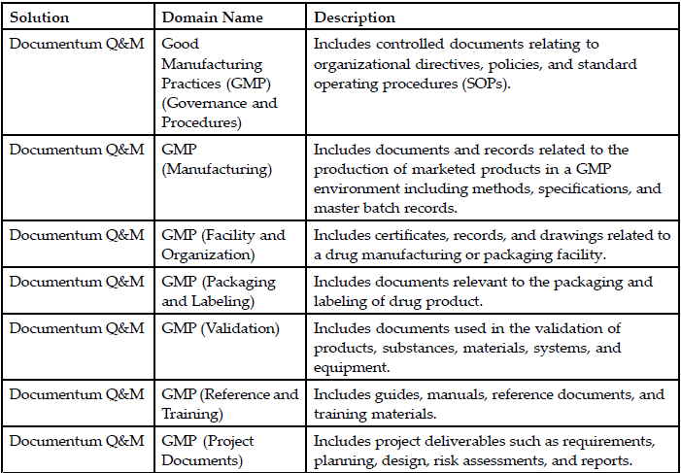
D2 LIFE SCIENCESSOLUTION SUITE –DOCUMENT DOMAINS
Please add the graphic description here.
Click Play to continue.
Notes:
Please add the audio note here.

Slide 6
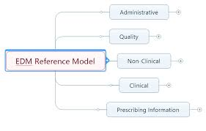
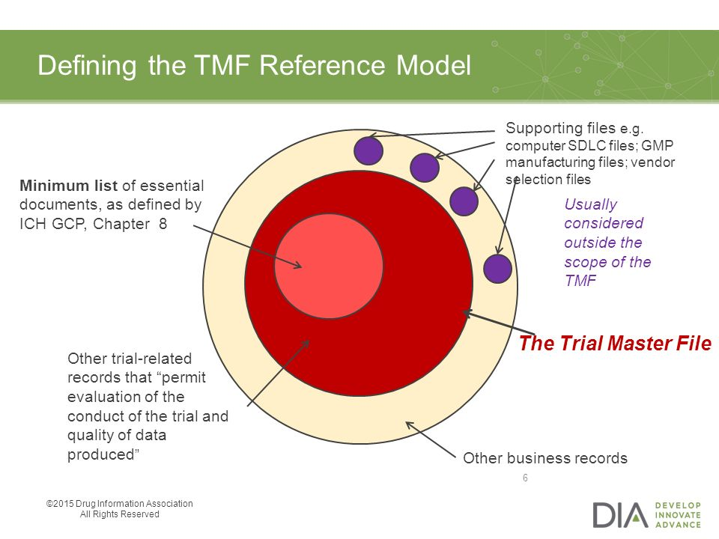
Reference Models
DIA – Drug information Association : Association More than 18000 life science company
EDM-Electronic Document Mgt : Focused on regulatory submission
TMF – Trial master file : Focused on clinical trial
Click Play to continue.
Notes:
Please add the audio note here.

Slide 7
Life Science Quality and Manufacturing (LSQM)
Click Play to continue.

Slide 8
LSQM Overview
Please add the graphic description here.
An out of the box solution to control quality and manufacturing documentation.
Part of the EMC Documentum Life Sciences solution suite.
Automate workflows across the extended enterprise, and ensure compliance with Good Manufacturing Practices (GMP) standards.
Modern, personalized interface.
Auditing, reporting and e-signature support for compliance, lifecycle management and document control services.
Industry-specific document taxonomies.
Click Play to continue.
© Cognizant 2020 |
Notes:
Please add the audio note here.

Slide 9
QUALITY AND MANUFACTURING - CHALLENGES
Time-consuming manual review and approval processes
Maintaining compliance while providing a user friendly system
Inability to ensure effective change control
Difficulty tracking compliance with “Read and Understood” requirements
Lack of print controls, watermarking, and other distribution control issues
Risk of fines & delays for GMP violations
Difficulty in distributing current (effective) documentation to global users
Slow response to changing business requirements that necessitate system changes and re-validation
Maintaining a single, auditable source of truth for managing controlled quality and submissions documentation
Click Play to continue.
© Cognizant 2020 |
Notes:
Please add the audio note here.

Slide 10
LSQM – KEY FEATURES
Predefined industry-standard data models, dictionaries, and taxonomies
Enables Title 21 CFR PART 11 compliance including electronic signature capabilities
Automated policy enforcement and audit trails
Automated document routing
Document overlays and watermarks tailored to business needs
Flexible lifecycles and workflows with four levels of control to streamline approval
Change request form and process to support document change control practices
Simplified document handling based on metadata and policy inheritance
Enforced signatures in review and approval tasks ensures compliant policies
View, export, and print control for managing controlled documents
Click Play to continue.
© Cognizant 2020 |
Notes:
Please add the audio note here.

Slide 11
LSQM - BENEFITS
Please add the graphic description here.
MANAGE AND STREAMLINE
controlled documents and workflows while ensuring compliance
Maintain compliance in a user friendly system
Manage process documentation
Distribute documentation globally
Ensure proper change control
Click Play to continue.
© Cognizant 2020 |
Notes:
Please add the audio note here.

Slide 12
LSQM - DOCUMENTS TYPES
Please add the graphic description here.
Change Requests - Includes documents used for the purpose of change management.
Governance and Procedure -Includes documents relating to organizational directives, policies and SOPs.
Manufacturing - Includes methods, specifications and master batch records.
Facility and Organization - Includes certificates, records and drawings related to a drug manufacturing or packaging facility.
Packaging and Labeling - Includes documents relevant to the packaging and labeling of drug product.
Validation - Includes documents used in the validation of products, substances, materials, systems and equipment.
Reference and Training - Includes guides, manuals, reference documents and training materials.
Project Documents - Includes project deliverables such as requirements, planning, design, risk assessments and reports.
Click Play to continue.
© Cognizant 2020 |
Notes:
Please add the audio note here.

Slide 13
LSQM - DOCUMENT CATEGORIES
Category 1
Independent Review and approval Process
Approval with electronic signatures for specific document types.
Additional approval by the Quality Organization department.
Controlled release by Document Coordinators.
Controlled release that can be deferred until a specified effective date.
Effective/Approved/Final versions that automatically withdrawn on expiration.
Effective/Approved/Final versions that can be reinstated and suspended on demand.
Effective/Approved/Final versions that can be superseded when the next version becomes effective.
Expiration notifications.
Category 2
Review and approval Process
Approval with electronic signatures for specific document types.
Documents that become effective immediately.
Effective/Approved/Final versions that can be suspended and reinstated on demand.
Effective/Approved/Final versions that can be superseded when the next version becomes effective.
Category 3
Enables self-approval by Authors.
Makes the previously Effective/Approved/Final version superseded when the next version becomes effective.
Allows the Effective/Approved/Final version to be suspended and reinstated on demand
Category 4
Non-controlled general documents
Do not require formal review or approval.
Not allowed in regulatory submissions.
Authors manage access to these documents.
Click Play to continue.
© Cognizant 2020 |
Notes:
Please add the audio note here.

Slide 14
LSQM – USER ROLES
Authors - Document Authors create documents and submit them for collaborative editing, review, and approval.
Approvers - Document Approvers are responsible for approving controlled documents.
Auditors - Document Auditors inspect the state of documents in their respective domain for audit-readiness.
Coordinators - Document Coordinators manage the release of controlled documents. They can also perform author’s role.
Document Coordinators monitor and manage the progress of document workflow tasks.
Quality Organization(QO) Approvers- QO Approvers perform the second-level of approval for Category 1 controlled documents.
Readers - Document Readers have read-only access to Effective versions of documents.
Reviewers - Document Reviewers review documents and edit documents using annotations.
Click Play to continue.
© Cognizant 2020 |
Notes:
Please add the audio note here.

Slide 15
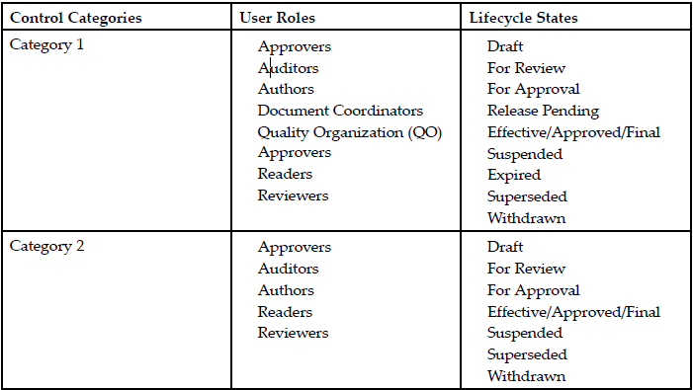
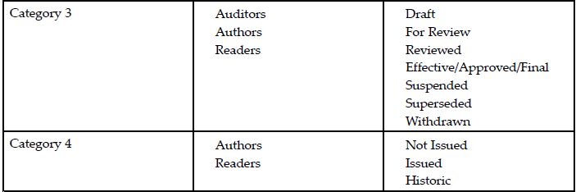
LSQM – ROLES AND CATEGORIES
Click Play to continue.
© Cognizant 2020 |
Notes:
Please add the audio note here.

Slide 16
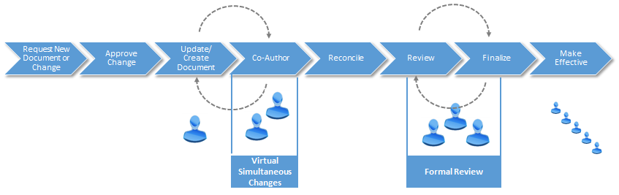
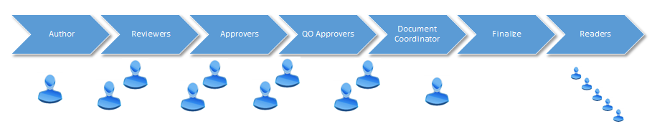
LSQM – HIGH LEVEL PROCESS
Please add the graphic description here.
Click Play to continue.
© Cognizant 2020 |
Notes:
Please add the audio note here.

Slide 17
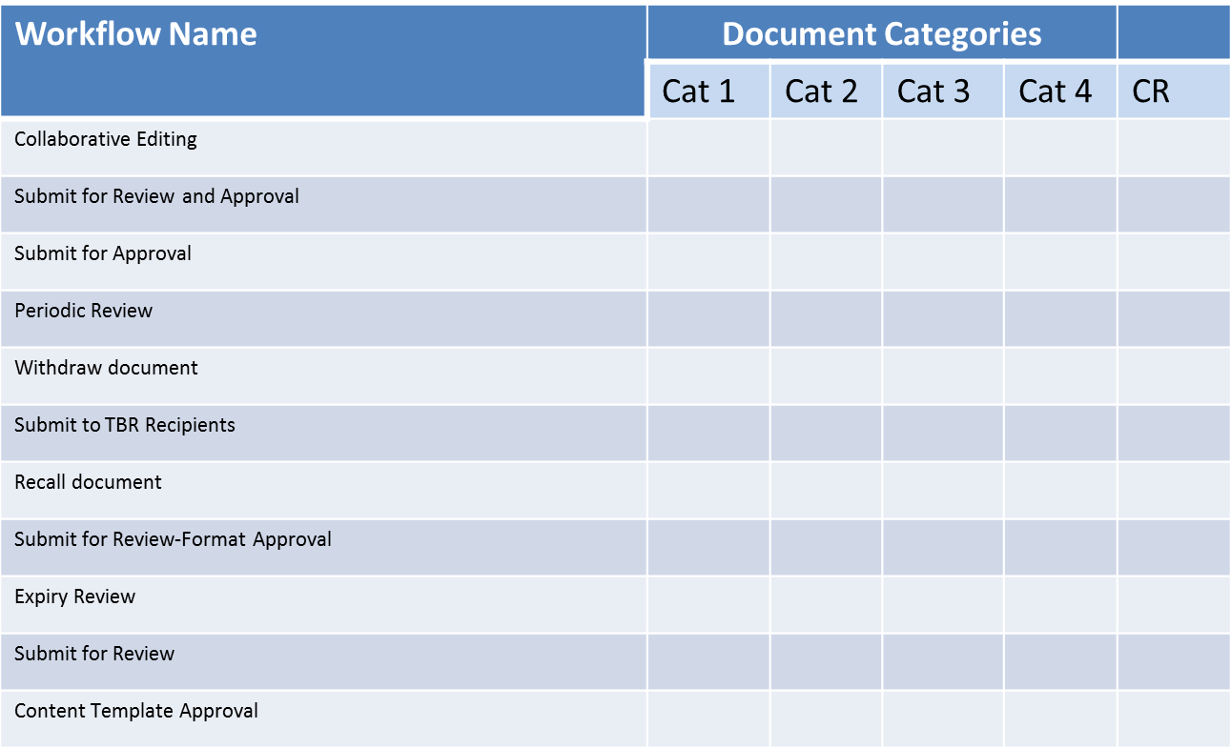
LSQM – DETAILED WORKFLOW PROCESSES
Please add the graphic description here.
Workflows listed above are built and configured, readily available OOTB.
Submit for Review(Cat2), Submit for Self Approval (Cat 2), Submit for Approval (Cat 3) and Submit for Self Approval (Cat 3) are built in system but not configured OOTB. Can be configured as per the business needs.
System supports building and configuring custom workflows as well.
Click Play to continue.
© Cognizant 2020 |
Notes:
Please add the audio note here.

Slide 18
LSQM – Learning Exercise
Category 1 Document
Create document.
Send the document for collaborative editing.
Create Change Request and associate the reconciled document.
Send the document to Review and Approval workflow.
Category 2 Document
Create document.
Send the document for Approval.
Category 3 Document
Create document.
Send the document for self Approval.
Click Play to continue.
© Cognizant 2020 |
Notes:
Please add the audio note here.

Slide 19
Reference Documents
Please add the graphic description here.
D2LS 16.4 documentation
https://ch1hub.cognizant.com/sites/SC6875/NovartisDCTMFactory/Training%20Material%20and%20Recordings/Forms/AllItems.aspx?RootFolder=%2Fsites%2FSC6875%2FNovartisDCTMFactory%2FTraining%20Material%20and%20Recordings%2FDocumentation%20and%20User%20Guides&FolderCTID=0x012000ABCEB548C4944A4F8E5048577101262A&View={1D1F608C-2EC6-4E2D-9BE4-5DD31EB941A6}&InitialTabId=Ribbon%2EDocument&VisibilityContext=WSSTabPersistence
D2 Training
https://ch1hub.cognizant.com/sites/SC6875/NovartisDCTMFactory/Training%20Material%20and%20Recordings/Forms/AllItems.aspx?RootFolder=%2Fsites%2FSC6875%2FNovartisDCTMFactory%2FTraining%20Material%20and%20Recordings%2FD2%20Recordings&FolderCTID=0x012000ABCEB548C4944A4F8E5048577101262A&View=%7b1D1F608C-2EC6-4E2D-9BE4-5DD31EB941A6%7d&InitialTabId=Ribbon%2EDocument&VisibilityContext=WSSTabPersistence
Click Play to continue.
© Cognizant 2020 |
Notes:
Please add the audio note here.

Slide 20
This is the Thank You slide.
Please add the graphic description here.
Thank You
Click the browser close button to exit the course.
Notes:
Please add the audio note here.

